Slide 1


Data Analysis
Notes:
Hello and welcome to the presentation, My name is Evans, and today I will be presenting to you the Data analysis project.

Slide 2


Today's agenda
Project recap
Problem
The Analytics team
Process
Insights
Summary
Notes:
Today's agenda is as follows:
1. We will recap the overall project to give a high-level understanding of the business problem we're tackling and the specific requirements.
2. We will dive into the specific problem that we, the Data Analytics team, have been focusing on and will give some background as to why this is such a big problem.
3. After introducing the problem, I will go over the team responsible from our side in tackling this task.
4. I will then go over the high-level process that we followed to complete this task so that you have complete clarity on how we tackle these kinds of tasks.
5. Finally, I will go over the all significant results and I will present them as a series of insights and visualizations from our analysis.
To wrap up, I will summarize and open any questions

Slide 3

Social Buzz is a fast-growing technology unicorn that needs to adapt quickly to its global scale.
Accenture has begun a 3 month POC focusing on these tasks:
An audit of Social Buzz’s big data practice
Recommendations for a successful IPO
Analysis to find Social Buzz’s top 5 most popular categories of content
Project Recap
Notes:
To kick things off let me recap this engagement.
We, Accenture have embarked on a 3-month pilot with Social Buzz to focus on 3 main tasks, aligned with some of the biggest challenges that you’re currently facing.
Social Buzz has reached a huge scale in recent years to become recognized as a global unicorn company. We are here to help you manage this scale and to guide you in the right direction.
Firstly, we will be doing an audit of your big data practice and sharing best practices and industry expertise. Secondly, we will be guiding you through a successful IPO, of which we have deep expertise and knowledge within our team. And finally, we have conducted an analysis of your data to find insights regarding your top 5 most popular categories of content.

Slide 4


Problem
Notes:
To answer the problem, the Data Analytics team has been specifically focusing on.
Clearly, your organization has such a grand scale, this comes with a lot of data, and with such vast amounts of data comes challenges.
To give a background on how much data you’ve been creating:
- You told us that your platform receives over 100000 posts per day which amounts to 36 500 000 posts every year, of which, this is all unstructured data making it very hard to make sense of.
In this day and age, content is king. Just look at some of the biggest platforms in the world, for example, YouTube, Facebook, and Netflix... they are all content businesses...
But how to capitalize on it when there is so much?
It's not just all about harvesting as much content as possible... The real value is in understanding and crunching this content to gain a deeper understanding of your audience and to therefore provide a more personalized and enjoyable experience.
And this is where our data analytics expertise comes in, with the insights that we've uncovered from this task, we can show you exactly how to take analytics to production at scale.

Slide 5



The Analytics team
Notes:
We have a large data analytics Experience team at Accenture, with only a team of three people primarily focusing on this task.
Andrew Fleming is our Chief Technical Architect and his expertise really helped to guide the team to produce high-quality analysis.
Marcus Rampton, a senior data expert has worked with the world’s biggest clients on solving their data problems and was heavily involved in the data engineering side of this project.
And finally, Evans was solely responsible for taking leadership guidance and delivering high-quality insights from the raw datasets and turning these into business decisions.

Slide 6
Process
1 Data Understanding
2 Data Cleaning
3 Data Modeling
4 Data Analysis
5 Uncover Insights
Notes:
Well, we approached the process in 5 steps:
1. Data understanding - The success of any data project is to understand the data in detail. therefore we took the time to understand the data model and domain of your business.
2. Data extraction - after understanding your business, we then architected what an ideal dataset should look like for this problem and extracted it from the relevant data sources.
3. After extracting the raw data, we needed to process and model this data into a dataset that can precisely answer the business questions and produce analytics.
4. With our new dataset, we used our analytical expertise to uncover insights from this dataset and to produce visualizations to describe the insights.
5. And finally we used these insights to unlock business decisions and to make recommendations on the next steps.

Slide 7

Insights
16
Unique Categories
1091
Reactions to “Food” posts
February
Month with
most posts
Notes:
According to our findings, From your data, we found that you had a total of 16 unique categories of posts across your sample dataset. This includes things such as Food, Culture, and Sport.
As well as this, there were 1091 posts from just the Food category alone! People obviously really like food!
And also the most common month for users to post within was December, since this is such a seasonal month with so many holidays and events, this is interesting to know that people are most active during this month!
But now, onto the main question... which is... what were the top 5 most popular categories of posts?

Slide 8
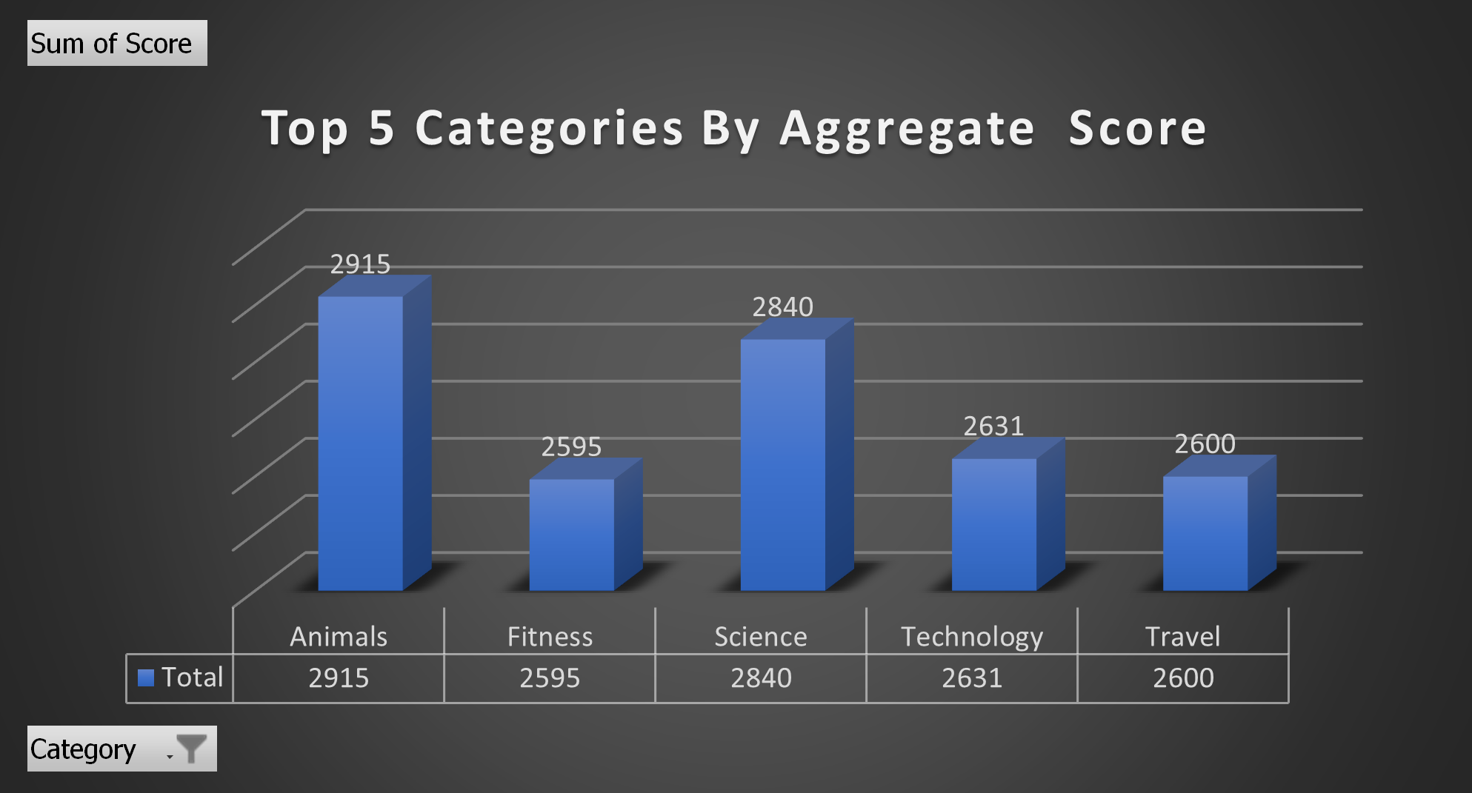
Notes:
From our analysis, you can see that the top 5 most popular categories of posts were food, culture, soccer, cooking and animals in descending order.
Food had an aggregate popularity score of almost 1100. It is very interesting to see both food and cooking within the top 5, it really shows what people enjoy consuming as content. But also interesting to see culture too. Clearly users favor "real-life" content on this platform.
Furthermore soccer is an interesting category because there is the European championships being played very soon. This presents a huge opportunity for you to differentiate your platform and to run specific content or events linked to this global spectacle.

Slide 9
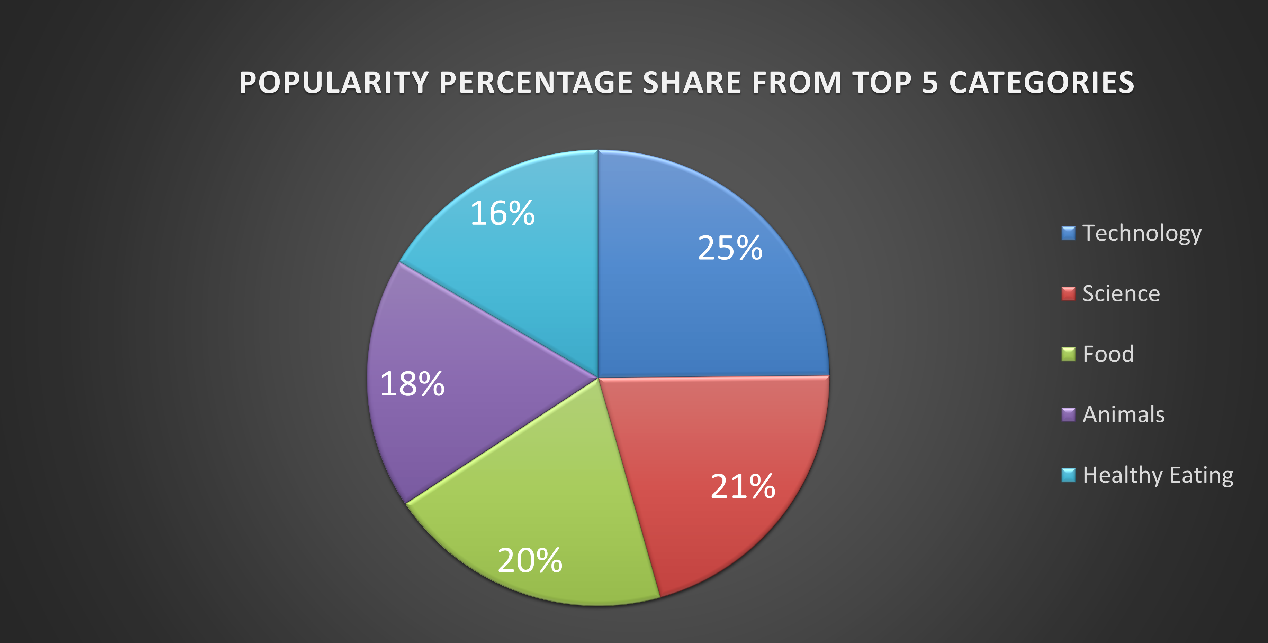
Notes:
Additionally, you can see from this chart the % split of popularity between the top 5 categories. There is not much difference between each of them, food only outperforms culture by 0.4% within the top 5.
However the difference between the 4th most popular, cooking, and the 5th most popular, animals, is much larger at 1.3%
This tells me that the categories sorted by popularity is weighted towards categories at the top. This means that it exhibits a "greedy" effect, the most popular categories get more popular whilst as you drop down the popularity rankings, you may see that they fall away drastically.

Slide 10

Summary
Notes:
So to summarize:
We tackled this task and found the top 5 most popular categories as asked, but we also went one step further.
- We found that food and culture are the two most popular categories, suggesting that users like "real-life" content
- We also found that soccer was the third most popular, perhaps due to the tournament coming up. This presents a massive opportunity for Social Buzz to ride on this global event, as all eyes will be on it as well as the players.
- As much as this analysis was insightful, we are ready to take it to the next stage and we have the expertise within Accenture to help you realize these kinds of insights in production across your organization and in real time. We would love to help you with this.

Slide 11

Thank you!
ANY QUESTIONS?
Notes:
Thank you very much for listening, please feel free to ask any questions that you may have!

